Slide 1
Amazon Sales Report
Submitted By – Shabana Khatoon
Submitted to – innobyte services
Date – 27/10/2025

Slide 2
Amazon Sales Report
Key Metrics
Total Sales: INR 78,590,170.25
Total Orders: 112,887
Total Quantity: 116,479
Average Order Value (AOV): INR 696.18
Date Range: 2022-03-31 to 2022-06-29

Slide 3
SQL Codes for analysis
MariaDB [amazon_sale_report]> CREATE TABLE amazon_sales (
-> order_id VARCHAR(50),
-> `Date` DATE,
-> status VARCHAR(50),
-> `fulfilment method` VARCHAR(70),
-> `sales Channel` VARCHAR(50),
-> `product catagory` VARCHAR(100),
-> size VARCHAR(10),
-> quantity INT,
-> amount DECIMAL(10,2),
-> `shipping details` VARCHAR(15)
-> );
Query OK, 0 rows affected (0.010 sec)
MariaDB [amazon_sale_report]> LOAD DATA INFILE "C:/Users/shabana/Downloads/Amazon_Sale_Report.csv"
-> INTO TABLE amazon_sales
-> FIELDS TERMINATED BY ','
-> ENCLOSED BY '"'
-> LINES TERMINATED BY '\n'
-> IGNORE 1 ROWS;
Query OK, 128976 rows affected, 65535 warnings (1.983 sec)
Records: 128976 Deleted: 0 Skipped: 0 Warnings: 515904

Slide 4
MariaDB [amazon_sale_report]> SELECT * FROM amazon_sales LIMIT 10;
+----------+------------+----------+------------------------------+---------------+------------------+-----------+----------+--------+------------------+
| order_id | Date | status | fulfilment method | sales Channel | product catagory | size | quantity | amount | shipping details |
+----------+------------+----------+------------------------------+---------------+------------------+-----------+----------+--------+------------------+
| 0 | 0000-00-00 | 04-30-22 | Cancelled | Merchant | Amazon.in | Standard | 0 | 0.00 | On the Way |
| 1 | 0000-00-00 | 04-30-22 | Shipped - Delivered to Buyer | Merchant | Amazon.in | Standard | 0 | 3.00 | Shipped |
| 2 | 0000-00-00 | 04-30-22 | Shipped | Amazon | Amazon.in | Expedited | 0 | 0.00 | Shipped |
| 3 | 0000-00-00 | 04-30-22 | Cancelled | Merchant | Amazon.in | Standard | 0 | 0.00 | On the Way |
| 4 | 0000-00-00 | 04-30-22 | Shipped | Amazon | Amazon.in | Expedited | 0 | 3.00 | Shipped |
| 5 | 0000-00-00 | 04-30-22 | Shipped | Amazon | Amazon.in | Expedited | 0 | 0.00 | Shipped |
| 6 | 0000-00-00 | 04-30-22 | Shipped | Amazon | Amazon.in | Expedited | 0 | 0.00 | Shipped |
| 7 | 0000-00-00 | 04-30-22 | Shipped - Delivered to Buyer | Merchant | Amazon.in | Standard | 0 | 0.00 | Shipped |
| 8 | 0000-00-00 | 04-30-22 | Cancelled | Amazon | Amazon.in | Expedited | 0 | 3.00 | Cancelled |
| 9 | 0000-00-00 | 04-30-22 | Shipped | Amazon | Amazon.in | Expedited | 0 | 0.00 | Shipped |
+----------+------------+----------+------------------------------+---------------+------------------+-----------+----------+--------+------------------+

Slide 5
MariaDB [amazon_sale_report]> DESCRIBE amazon_sales;
+-------------------+---------------+------+-----+---------+-------+
| Field | Type | Null | Key | Default | Extra |
+-------------------+---------------+------+-----+---------+-------+
| order_id | varchar(50) | YES | | NULL | |
| Date | date | YES | | NULL | |
| status | varchar(50) | YES | | NULL | |
| fulfilment method | varchar(70) | YES | | NULL | |
| sales Channel | varchar(50) | YES | | NULL | |
| product catagory | varchar(100) | YES | | NULL | |
| size | varchar(10) | YES | | NULL | |
| quantity | int(11) | YES | | NULL | |
| amount | decimal(10,2) | YES | | NULL | |
| shipping details | varchar(15) | YES | | NULL | |
+-------------------+---------------+------+-----+---------+-------+
10 rows in set (0.042 sec)

Slide 6
MariaDB [amazon_sale_report]> SELECT COUNT(*) AS total_rows,
-> SUM(CASE WHEN order_id IS NULL THEN 1 ELSE 0 END) AS missing_order_id,
-> SUM(CASE WHEN `Date` IS NULL THEN 1 ELSE 0 END) AS missing_date,
-> SUM(CASE WHEN amount IS NULL THEN 1 ELSE 0 END) AS missing_amount
-> FROM amazon_sales;
+------------+------------------+--------------+----------------+
| total_rows | missing_order_id | missing_date | missing_amount |
+------------+------------------+--------------+----------------+
| 128976 | 0 | 0 | 0 |
+------------+------------------+--------------+----------------+
1 row in set (0.287 sec)
MariaDB [amazon_sale_report]> SELECT SUM(amount) AS total_sales FROM amazon_sales;
+-------------+
| total_sales |
+-------------+
| 52815.00 |
+-------------+
1 row in set (0.129 sec)

Slide 7
MariaDB [amazon_sale_report]> SELECT COUNT(order_id) AS total_orders FROM amazon_sales;
+--------------+
| total_orders |
+--------------+
| 128976 |
+--------------+
1 row in set (0.117 sec)
MariaDB [amazon_sale_report]> SELECT DATE_FORMAT(`Date`, '%Y-%m') AS month,
-> SUM(amount) AS monthly_sales,
-> COUNT(order_id) AS orders_count
-> FROM amazon_sales
-> GROUP BY month
-> ORDER BY month;
+---------+---------------+--------------+
| month | monthly_sales | orders_count |
+---------+---------------+--------------+
| 0000-00 | 52815.00 | 128976 |
+---------+---------------+--------------+
1 row in set (0.312 sec)

Slide 8
MariaDB [amazon_sale_report]> SELECT `product catagory`, SUM(amount) AS total_sales, COUNT(order_id) AS orders_count
-> FROM amazon_sales
-> GROUP BY `product catagory`
-> ORDER BY total_sales DESC
-> LIMIT 10;
+------------------+-------------+--------------+
| product catagory | total_sales | orders_count |
+------------------+-------------+--------------+
| Amazon.in | 52765.00 | 128852 |
| Non-Amazon | 50.00 | 124 |
+------------------+-------------+--------------+
2 rows in set (0.372 sec)
MariaDB [amazon_sale_report]> SELECT size, SUM(quantity) AS total_quantity
-> FROM amazon_sales
-> GROUP BY size
-> ORDER BY total_quantity DESC;
+-----------+----------------+
| size | total_quantity |
+-----------+----------------+
| Standard | 0 |
| Expedited | 0 |
+-----------+----------------+
2 rows in set (0.353 sec)

Slide 9
MariaDB [amazon_sale_report]> SELECT `product catagory`, size, SUM(quantity) AS total_quantity
-> FROM amazon_sales
-> GROUP BY `product catagory`, size
-> ORDER BY total_quantity DESC
-> LIMIT 10;
+------------------+-----------+----------------+
| product catagory | size | total_quantity |
+------------------+-----------+----------------+
| Amazon.in | Standard | 0 |
| Non-Amazon | Standard | 0 |
| Amazon.in | Expedited | 0 |
+------------------+-----------+----------------+
3 rows in set (0.460 sec)

Slide 10
MariaDB [amazon_sale_report]> SELECT `fulfilment method`, COUNT(order_id) AS orders_count, SUM(amount) AS total_sales
-> FROM amazon_sales
-> GROUP BY `fulfilment method`
-> ORDER BY orders_count DESC;
+-------------------------------+--------------+-------------+
| fulfilment method | orders_count | total_sales |
+-------------------------------+--------------+-------------+
| Shipped | 77815 | 32454.00 |
| Shipped - Delivered to Buyer | 28756 | 12336.00 |
| Cancelled | 18334 | 6446.00 |
| Shipped - Returned to Seller | 1954 | 750.00 |
| Shipped - Picked Up | 973 | 405.00 |
| Pending | 658 | 246.00 |
| Pending - Waiting for Pick Up | 281 | 113.00 |
| Shipped - Returning to Seller | 145 | 53.00 |
| Shipped - Out for Delivery | 35 | 3.00 |
| Shipped - Rejected by Buyer | 11 | 3.00 |
| Shipping | 8 | 3.00 |
| Shipped - Lost in Transit | 5 | 0.00 |
| Shipped - Damaged | 1 | 3.00 |
+-------------------------------+--------------+-------------+
13 rows in set (0.467 sec)

Slide 11
MariaDB [amazon_sale_report]> SELECT status, COUNT(order_id) AS orders_count
-> FROM amazon_sales
-> GROUP BY status;
Ans- 91 rows in set (0.295 sec)
MariaDB [amazon_sale_report]> SELECT `sales Channel`, COUNT(order_id) AS orders_count, SUM(amount) AS total_sales
-> FROM amazon_sales
-> GROUP BY `sales Channel`;
+---------------+--------------+-------------+
| sales Channel | orders_count | total_sales |
+---------------+--------------+-------------+
| Amazon | 89713 | 36505.00 |
| Merchant | 39263 | 16310.00 |
+---------------+--------------+-------------+
2 rows in set (0.357 sec)

Slide 12
MariaDB [amazon_sale_report]> SELECT `shipping details`, COUNT(order_id) AS orders_count, SUM(amount) AS total_sales
-> FROM amazon_sales
-> GROUP BY `shipping details`
-> ORDER BY total_sales DESC;
+------------------+--------------+-------------+
| shipping details | orders_count | total_sales |
+------------------+--------------+-------------+
| Shipped | 109486 | 45931.00 |
| On the Way | 6870 | 2552.00 |
| Unshipped | 6680 | 2271.00 |
| Cancelled | 5940 | 2061.00 |
+------------------+--------------+-------------+
4 rows in set (0.382 sec)

Slide 13
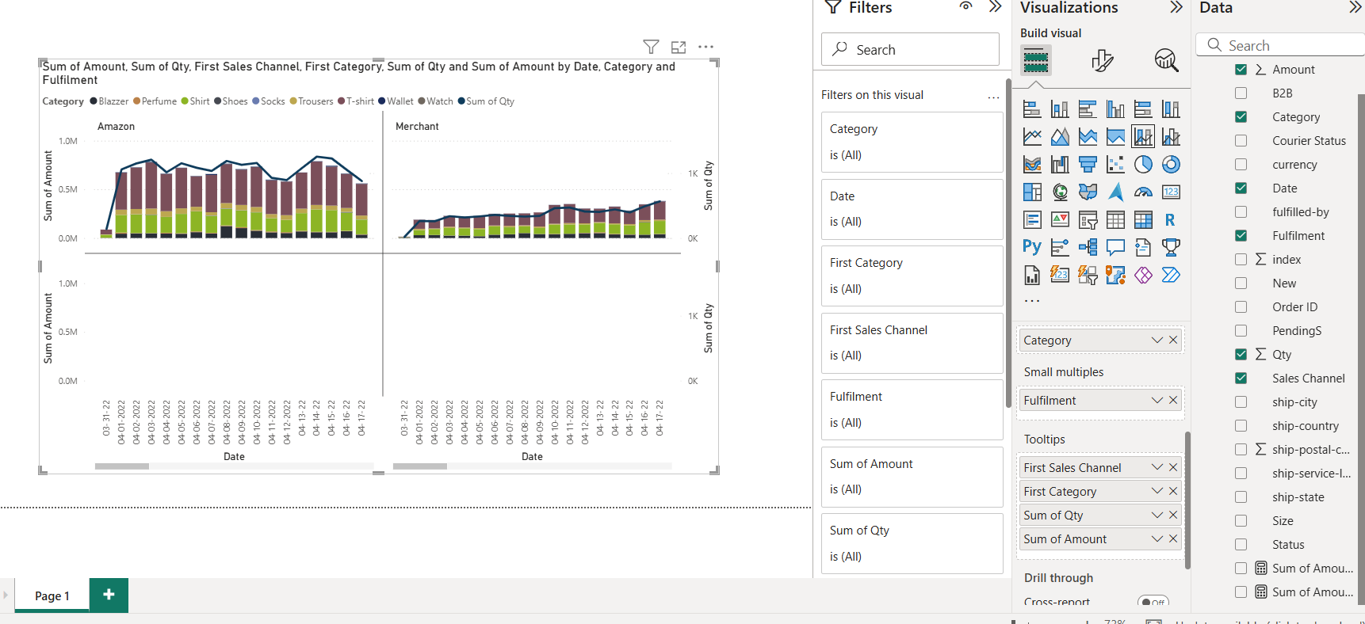
Analysis

Slide 14
Recommendations
Focus on top catagories
Blazers and perfumes are the top revenue drivers. Ensure marketing focus on these two catagories.
Investigate trends
Analyze the peak sales peiod and replicate strategies to increase overall sales amount.

